Slide 1
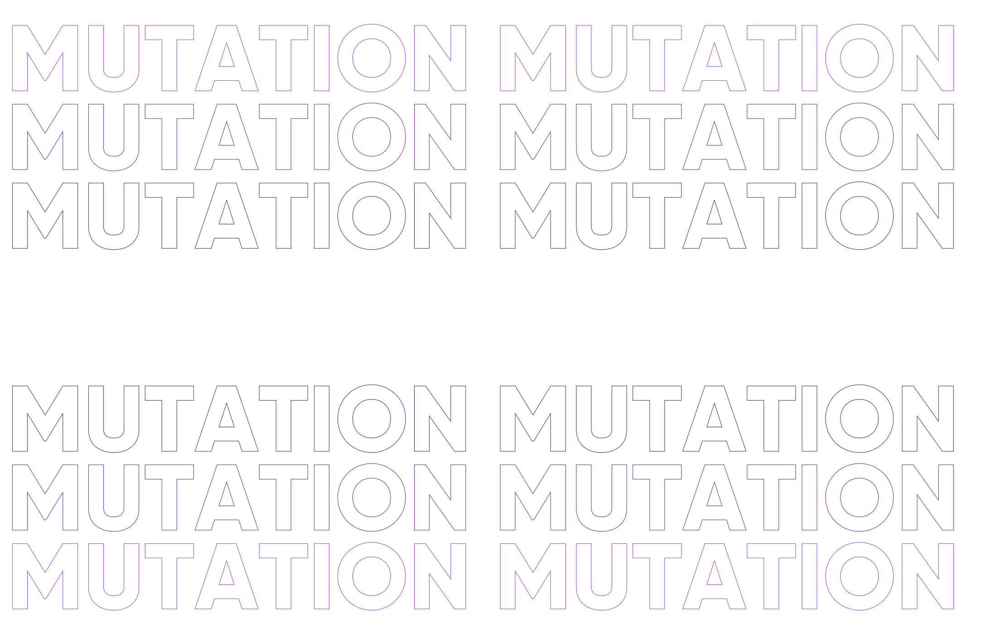

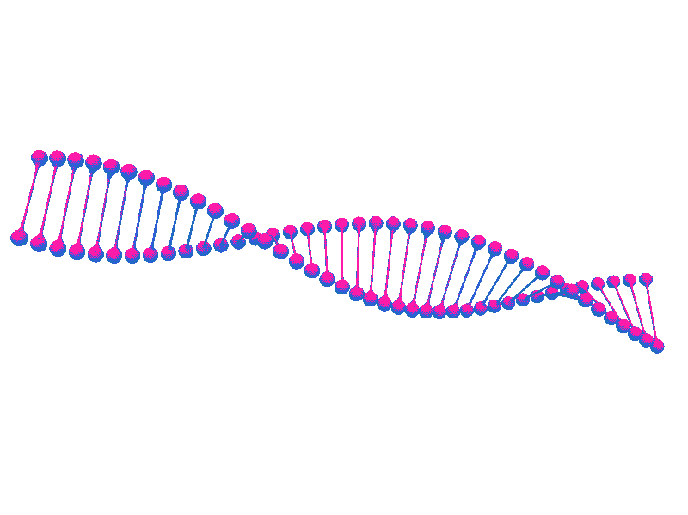

2:
Competency
BIOLOGY LEARNING STATION STRATEGIES (BLISS)

Slide 2
Content Standards:
The learners demonstrate an understanding of
the information stored in DNA is being used to make proteins.
how changes in DNA molecule may cause changes in its product.
Competency:
Explain how mutations may cause changes in the structure and function of a protein. S10LT - IIIe -38.
Objectives:
At the end of the material the student will be able to:
illustrate different types of chromosomal mutations;
differentiate the kinds of chromosomal mutations; and
value the significant understanding of genetic mutation and how it may affect one life.

Slide 3
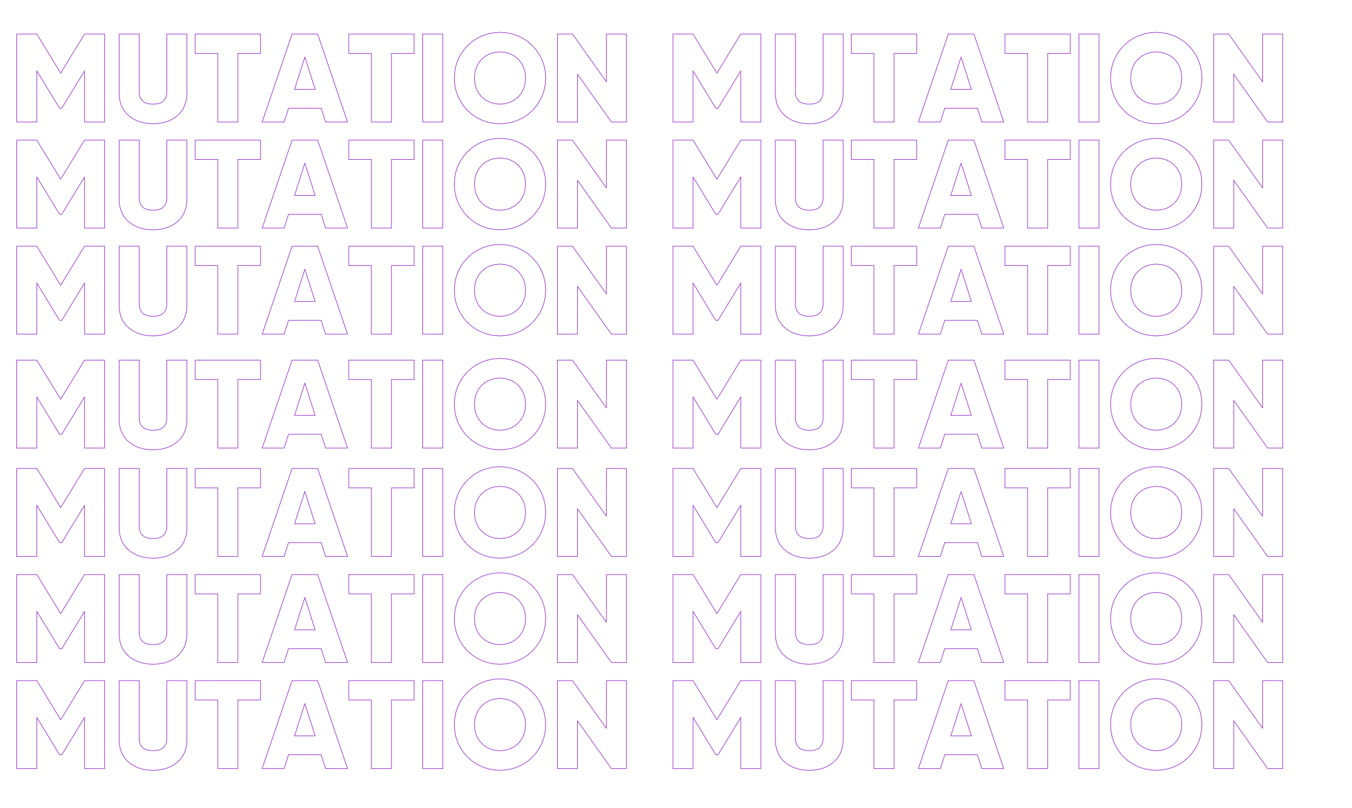
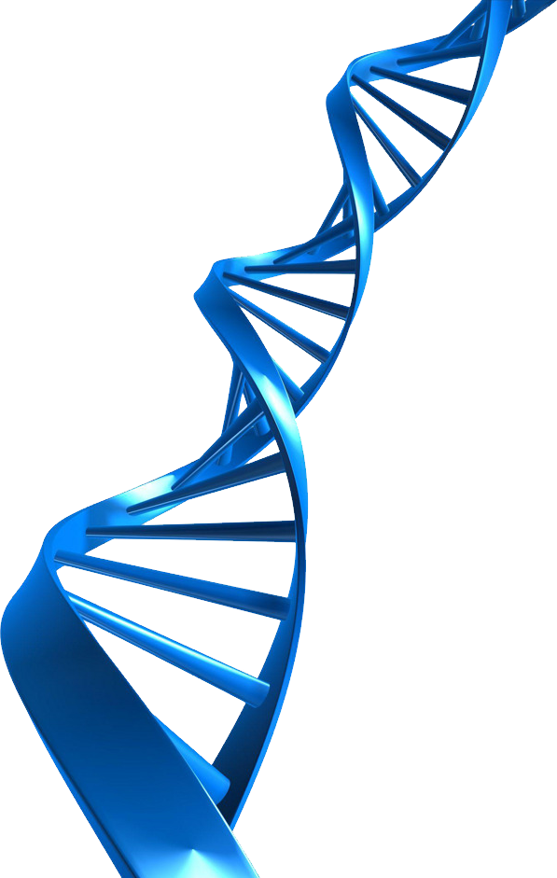
Introduction
The DNA is required to complete the protein production process. Transcription and translation are the two processes of protein synthesis. Messenger RNA sequences are read and translated into amino acids at the ribosome during protein production. Proteins will be formed from these amino acids.
Codons, which are carried by mRNA, specify these amino acids. The genes will be abnormal if the transcription process is incorrectly replicated. This is referred to as a mutation. A mutation is a change in our DNA sequence that happens as a consequence of errors during DNA copying or environmental influences such as UV radiation and cigarette smoke. Because DNA replication involves mutation, transcription into mRNA is unusual.

Slide 4
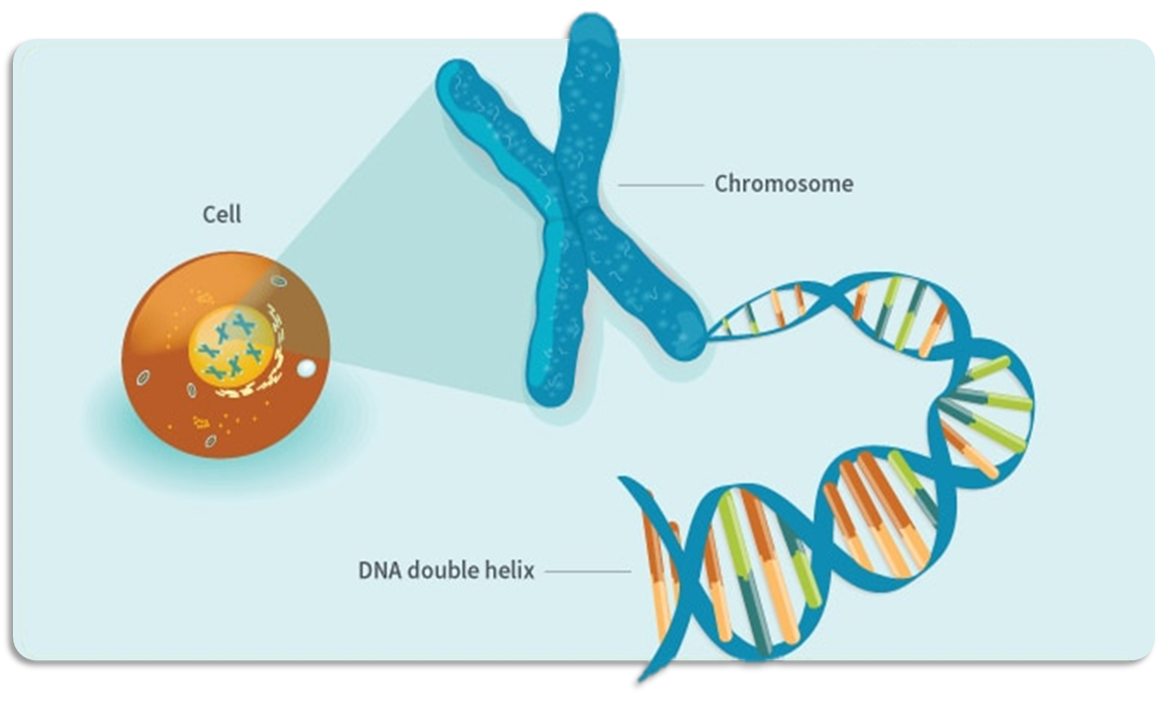
Deoxyribonucleic Acid
DNA (deoxyribonucleic acid) is the molecule that conveys genetic information for an organism's development and function. DNA is made up of two connected strands that loop around each other like a twisted ladder, giving it the form of a double helix

Slide 5
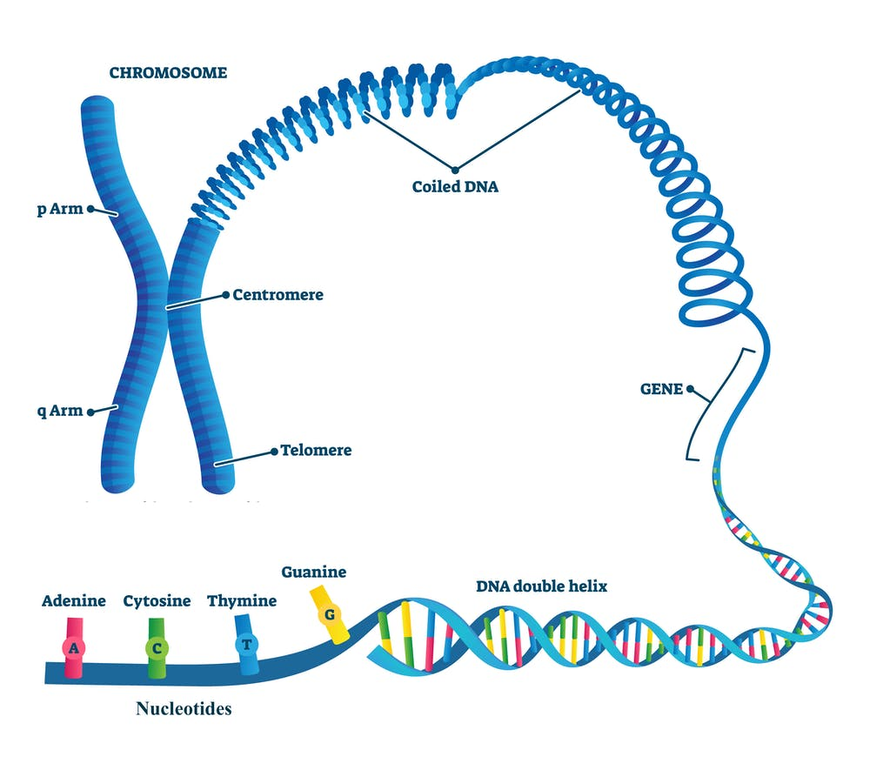
Deoxyribonucleic Acid
The backbone of each strand is made up of alternating sugar called deoxyribose and phosphate groups. Each sugar has one of four bases attached to it: adenine (A), cytosine (C), guanine (G), or thymine (T). Chemical linkages between the bases connect the two strands.
Adenine (A) binds with thymine (T)
Cytosine (C) binds with guanine (G)

Slide 6
Deoxyribonucleic Acid
The nucleotide sequence along DNA's backbone encodes biological information such as protein or RNA molecule instructions.

Slide 7
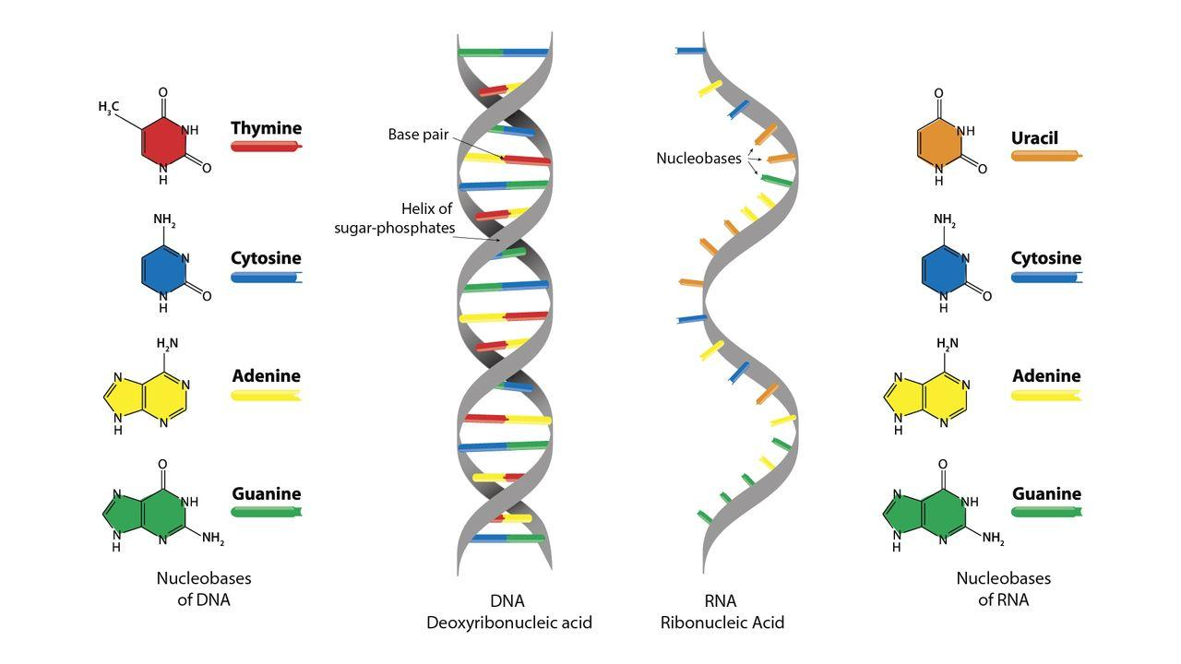
Ribonucleic Acid
Ribonucleic acid (RNA) is a nucleic acid that has structural similarities to DNA and is found in all living organisms. RNA, unlike DNA, is almost always single-stranded. Instead of the deoxyribose present in DNA, an RNA molecule contains a backbone consisting of alternating phosphate groups and the sugar called ribose. Each sugar has one of four bases attached to it: adenine (A), uracil (U), cytosine (C), or guanine (G). In cells, there are three forms of RNA which are messenger RNA (mRNA), ribosomal RNA (rRNA), and transfer RNA (tRNA).

Slide 8
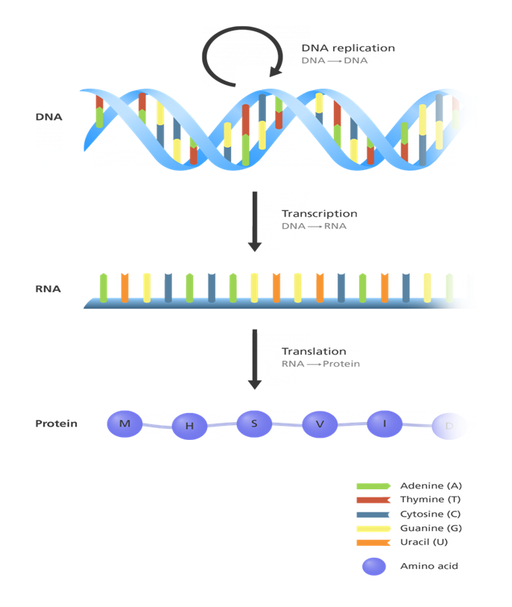
Gene Expression
(Central Dogma)
The Central dogma depicts the flow of genetic information in cells, DNA replication, and transcription, which codes for RNA, which then codes for proteins through translation

Slide 9
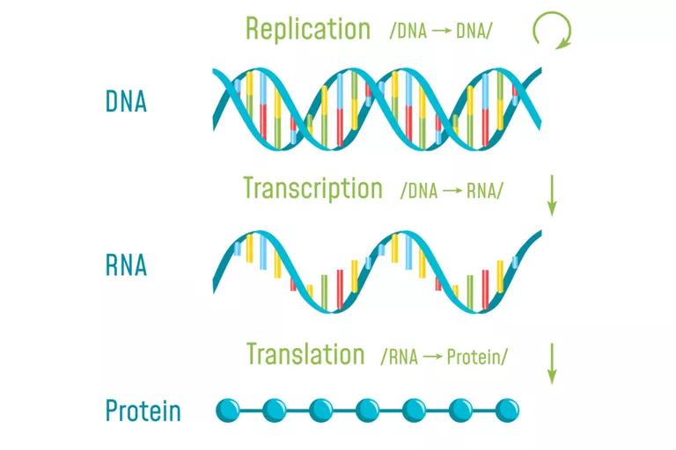
Transcription
DNA transcription is the process by which RNA polymerase rewrites the genetic information contained in DNA into messenger RNA (mRNA). The mRNA then leaves the nucleus and serves as the foundation for DNA translation. The cell regulates the pace of gene expression by managing the creation of mRNA within the nucleus.
Example:
DNA Replicated sequence – ACGGGTAAGG
Transcribed mRNA – UGCCCAUUCC
This code will be carried by mRNA to the ribosomes, instructing them on how to produce a protein.

Slide 10
Translation
The translation is the process of converting information transmitted from DNA as messenger RNA into a sequence of amino acids linked by peptide bonds. It's a conversion from one code (nucleotide sequence) to another (amino acid sequence).

Slide 11
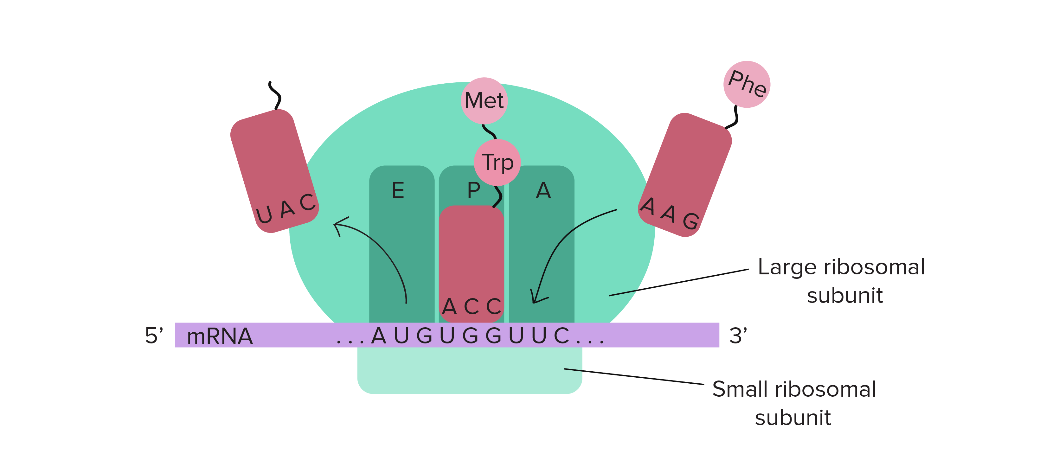
Translation
This process takes place on the ribosome, much as mRNA synthesis takes place on the RNA polymerase. The ribosome matches the three complementary bases in the anticodon sections of tRNA molecules to the base sequence on the mRNA in sets of three bases called codons. The base-pairing rule is crucial in this identification once again Adenine (A) binds to Uracil (U) and Cytosine (C) binds to Guanine (G).

Slide 12
Translation
The ribosome travels along the mRNA chain, matching three base pairs at a time, and adds amino acids to the polypeptide chain. The ribosome releases both the polypeptide and the mRNA when it reaches one of the "stop" codes. This polypeptide will twist back into its original shape and begin to function as a protein.

Slide 13
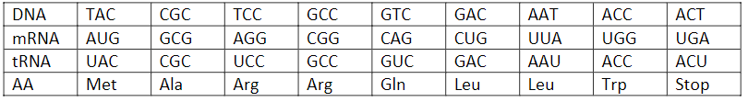
Translation
Example:

Slide 14
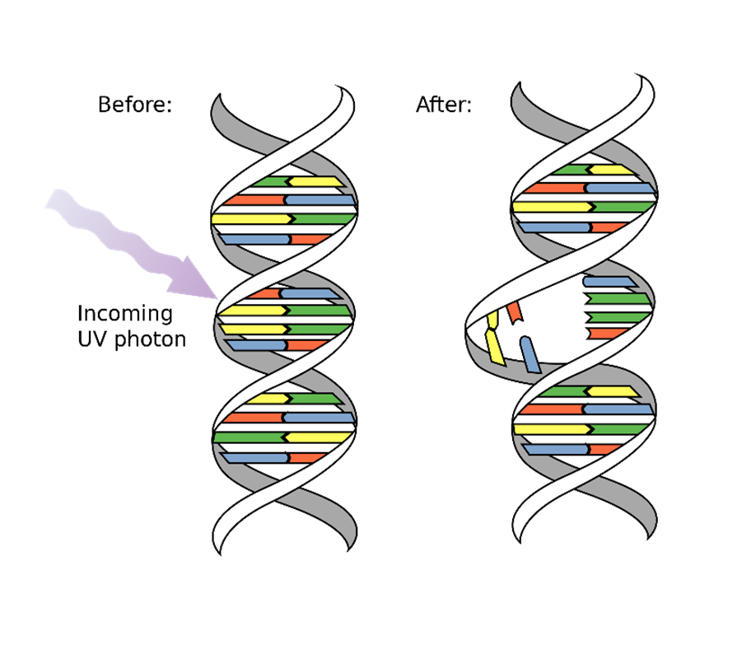
Mutation
A mutation is a change in the sequence of DNA. In the same way that DNA contains information, Mutations are errors in the genetic coding of amino acids that usually happen in transcription. There are two types of mutation; gene mutation and chromosomal mutation.

Slide 15
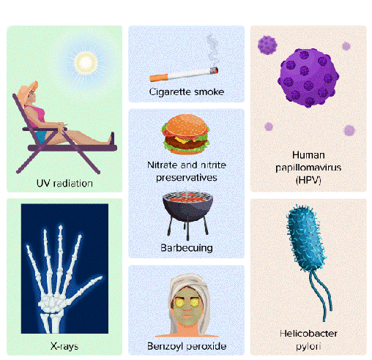
Mutation
Mutagens are substances that change DNA and can cause cancer. Permanent changes in the DNA sequence are caused by an organism's capacity to repair the damage. Radioactive substances, x-rays, UV light, and some chemicals or medications are examples of mutagens.

Slide 16
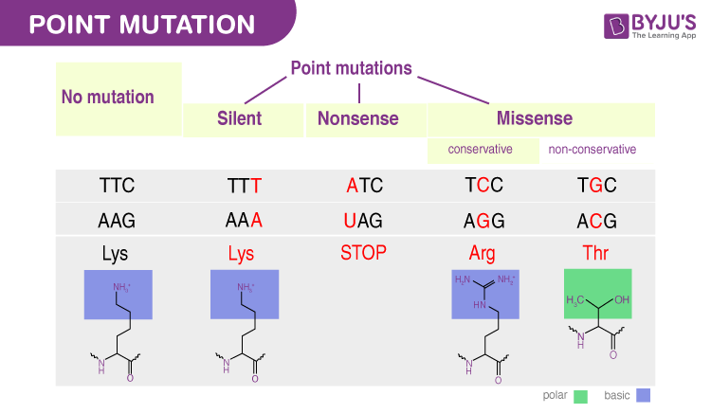
Mutation
It is a DNA or RNA mutation in which a single nucleotide base is deleted, inserted, or changed. Substitution mutation can exist as a result of this. Substitution mutation can have three forms. These are nonsense, missense, and silent mutation.

Slide 17
Mutation
1. Nonsense Mutation
Due to the replacement of one nitrogenous nucleotide, nonsense mutation leads to the development of a stop codon. Stop codons are nitrogenous nucleotides that halt the translation step of protein synthesis. In DNA, they are ATC, ATT, or ACT, while in mRNA, they are UAG, UAA, or UGA. They are frequently found near the end of the nucleotide base sequence of messenger RNA. When a substitution mutation leads it to emerge in a different location, the translation process to amino acid is abruptly stopped and the right protein is not produced.

Slide 18
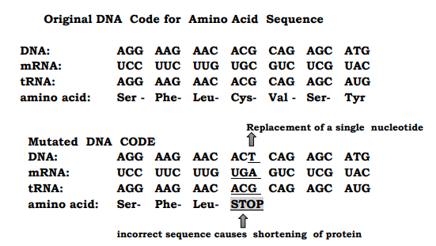
Mutation
1. Nonsense Mutation

Slide 19
Mutation
2. Missense Mutation
Missense mutation occurs when one nitrogenous base of the DNA is changed, resulting in an altered codon but without forming a stop codon.
This results in the formation of new amino acids during protein synthesis.
Example:
DNA: CAT to mRNA: GUA to tRNA CAU (Valine)
CAT is changed into CCT to mRNA: GGA to tRNA: CCU (Glycine)

Slide 20
Mutation
2. Missense Mutation
Missense mutations are divided into two types: conservative and non-conservative.
Conservative mutation occurs when the newly created amino acid has the same qualities as the one that was intended to be produced.
Non-conservative occurs when the newly generated amino acid differs from the one that was expected to be created.

Slide 21
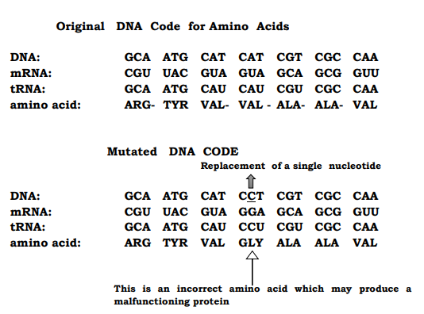
Mutation
2. Missense Mutation

Slide 22
Mutation
3. Silent Mutation
Silent mutation occurs when a nitrogenous base is mutated while producing the same amino acid. Keep in mind that many codons might code for the same amino acid. GGC and GGU, for example, can both code for glycine. If C is changed to U, the same amino acid is generated, and so the amino acid is not modified or altered

Slide 23
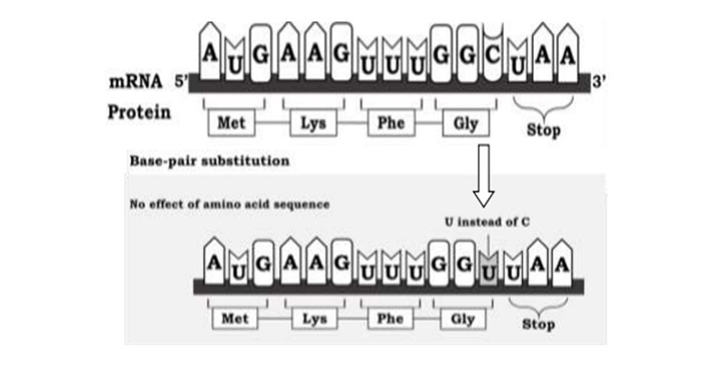
Mutation
3. Silent Mutation

Slide 24
Mutation
Frameshift mutation occurs when the regular sequence of codons is disrupted by the insertion or deletion of one or more nitrogenous bases, where the number of nitrogenous bases inserted or deleted is not a multiple of three. For example, if only one nucleotide is removed, all codons after the mutation will have an altered reading frame. This can result in the integration of various modifications in amino acids into the protein, which can disrupt the amino acid chain. When three nitrogenous bases are deleted or inserted, there is no change in the codon reading frame, but there is either an additional or missing amino acid in the protein. As a result, frameshift mutations result in an aberrant protein with an incorrect amino acid sequence that might be longer or shorter than the normal protein.

Slide 25
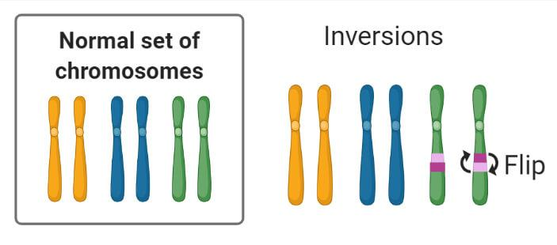
Mutation
Kinds of Frameshift Mutation:
1. Inversion
The chromosome is inverted, and its segments are reversed from end to end. A fragment of the chromosome is taken and then reattached, but oppositely as before.

Slide 26
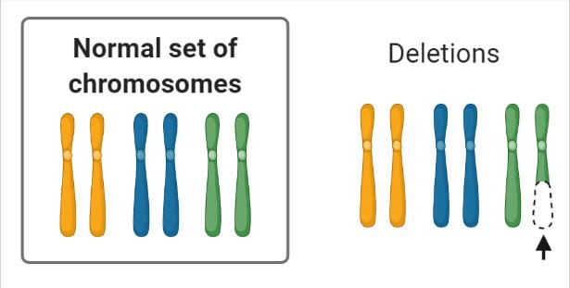
Mutation
Kinds of Frameshift Mutation:
2. Deletion
These arise when a chromosomal fragment is unintentionally removed or deleted. There are circumstances when one piece is removed at the end (terminal deletion), two deletions when one is within the chromosome, and one at the end (interstitial deletion).

Slide 27
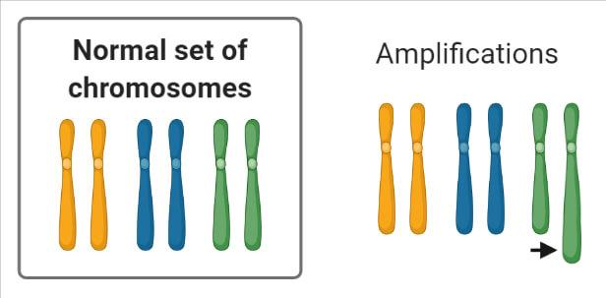
Mutation
Kinds of Frameshift Mutation:
3. Duplication/Amplification
Occurs when the nucleus has an extra copy of a segment or the complete chromosome. These are sometimes referred to as incomplete trisomies. In the case of duplication, an organism that normally has two copies of a chromosome will often have three. This can occur anywhere throughout the chromosome, including the middle and ends.

Slide 28
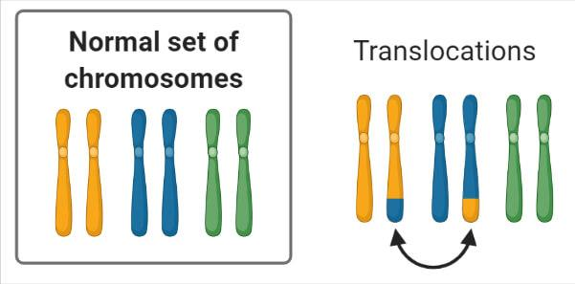
Mutation
Kinds of Frameshift Mutation:
4. Translocation
This occurs when a fragment of a chromosome breaks off and moves to a separate chromosome. As one kind of chromosome fuses with another, fusion chromosomes are formed.

Slide 29
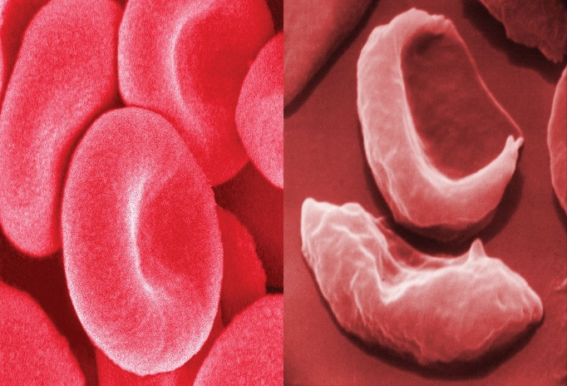
Effects of Mutated Genes
This form of anemia is caused by a recessive condition induced by a single substitution mutation in the gene that produces hemoglobin. Hemoglobin is well-known for transporting oxygen throughout the body. Glutamic acid is generated in the chain of a normal gene. However, when the amino acid valine replaces glutamic acid, sickle-shaped blood cells are produced. These cells are unable to transport oxygen correctly. Anemia, pain crises, and recurrent infections are signs of sickle cell anemia. Prescription medicines, folic acid, bone marrow transplants, and blood transfusions can all help

Slide 30
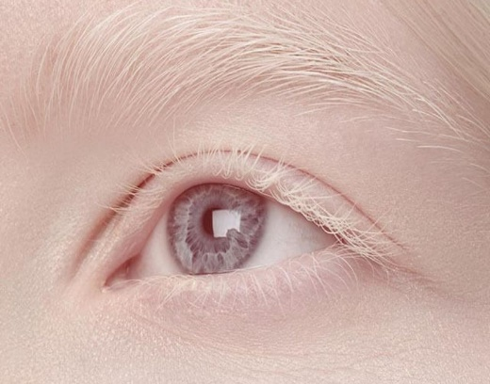
Effects of Mutated Genes
It is an autosomal recessive condition caused by a deletion mutation in which melanin synthesis is decreased or nonexistent in skin, hair, and eyes due to tyrosinase inactivity. The loss of the tyrosinase gene causes this.

Slide 31
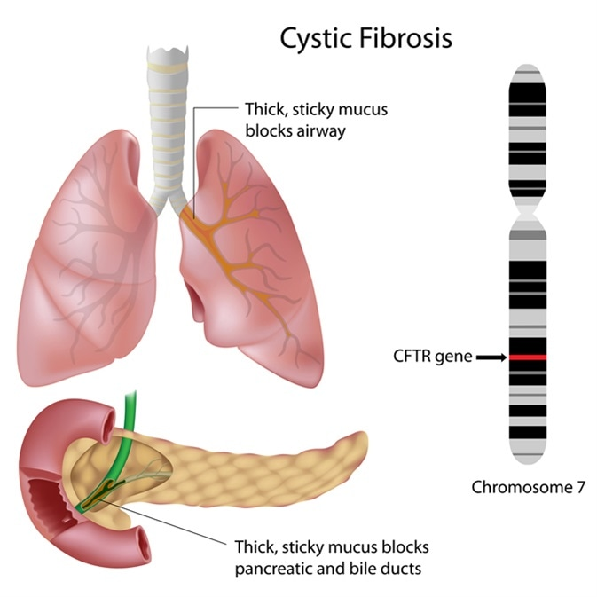
Effects of Mutated Genes
Is an inherited recessive condition. Although many distinct variants can cause cystic fibrosis, the deletion mutation is the most prevalent. It affects the cystic fibrosis transmembrane conductance regulator (CFTR) gene, causing the amino acid phenylalanine to be deleted. This results in an erroneous protein.

Slide 32
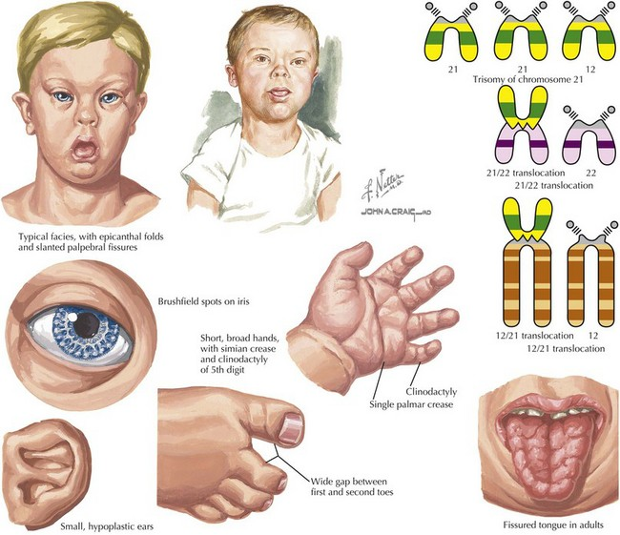
Effects of Mutated Genes
Is associated with mild cognitive impairment. It is also distinguished by physical development, body, and facial characteristics impairment. Down syndrome is caused by a meiotic translocation that transfers the majority of chromosome 21 onto chromosome 14.

Slide 33


STATION 2:
Activity 1
Activity 2
Assessment 2

Slide 34
Activity 1
Modeling of Chromosomal Mutations!
(Mastery Modelling)
Materials:
i. Little bit pieces of paper
ii. Pencil
iii. Tape
Procedure:
Write numbers 1-8 on pieces of paper (one number for each piece). Tape the pieces together in numerical order to create a model of a chromosome with 8 genes.
Use the "chromosome" you created to model four changes in chromosome structure. For example, remove the number 3 and rejoin the remaining chromosome segments to represent a deletion.
Reconstruct the original chromosome before modeling inversion, deletion, duplication, and translocation. Use the extra pieces of paper to make the additional numbers you need.
You have 10 minutes to construct the model.
When time is up, prepare for the presentation of your model.

Slide 35
Guide Questions:
How long does a regular menstrual cycle last?
Describe what happens to an egg during the first 14 days of the cycle in Part A.
Describe what happens to the egg if fertilization occurs.
Explain what takes place in the uterus after fertilization.
Why is it important to study the menstrual cycle?

Slide 36
Activity 2
Chromosomal Mutation
(Individual Activity)

Slide 37
SUM IT UP! In __________, the chromosome is inverted, and its segments are reversed from end to end. In __________, a chromosomal fragment is unintentionally removed or deleted. In __________, are sometimes referred to as incomplete trisomies. In __________, a fragment of a chromosome breaks off and moves to a separate chromosome.

Slide 38
Assessment 2
Competency 2
Describe the feedback mechanisms involved in regulating processes in the female reproductive system (e.g., menstrual cycle) S10LT – IIIc -35
Direction: Choose the letter of the correct answer.
What can occur in two different types of cells: the reproductive and body cells?
Mutations
RNA
Gene mutation
Chromosomal mutation
What is a permanent change in the DNA sequence that makes up a gene?
Mutations
RNA
Gene mutation
Chromosomal mutation
__________ occurs at the chromosome level resulting in gene deletion, duplication, or rearrangement.
Mutations
RNA
Gene mutation
Chromosomal mutation

Slide 39
It occurs when a piece of one chromosome breaks off and attaches to another chromosome. What kind of chromosomal mutation is this?
Chromosomal Deletion
Chromosomal Inversion
Chromosomal Translocation
Chromosomal Duplication
When a piece or section of chromosomal material is missing, this is referred to as partial monosomy. What kind of chromosomal mutation is this?
Chromosomal Deletion
Chromosomal Inversion
Chromosomal Translocation
Chromosomal Duplication
A chromosomal rearrangement in which a chromosome segment is reversed end-to-end. What kind of chromosomal mutation is this?
Chromosomal Deletion
Chromosomal Inversion
Chromosomal Translocation
Chromosomal Duplication
Involves the production of one or more copies of a gene or chromosomal region. What kind of chromosomal mutation is this?
Chromosomal Deletion
Chromosomal Inversion
Chromosomal Translocation
Chromosomal Duplication

Slide 40
The Homologous pair of chromosomes are arranged in what characteristics?
Size
Numbers
Activity
Frequency
How do three chromosomal aberrations differ from one another?
They are different by the frequency of smaller genes
They are different by the number of genes within the chromosome.
They are different by the descending sizes of the genes within the chromosome.
They have no distinct difference.
This abnormality is caused by an extra chromosome in chromosome 18.
Down Syndrome
Edwards Syndrome
Klinefelter's Syndrome
Turner's syndrome
This abnormality causes the female sexual characteristic to be underdeveloped.
Down Syndrome
Edwards Syndrome
Klinefelter's Syndrome
Turner's syndrome

Slide 41
Cri du chat which is an abnormality that causes babies to make high-pitched cries is a result of?
Deletion of the short part of chromosome 5
Duplication of the short part of chromosome 6
Deletion of the short part of chromosome 6
Duplication of the short part chromosome 5
Why is a specific base pairing essential for transcription and translation?
Because specific base pairing dictates the particular type of amino acids to be created
Because specific base pairing powers the translation and transcription processes
Because specific base pairing is our defense for specific kinds of mutations
The specific base pairing has no influence on the two-process stated.
Protein X's eleventh amino acid should be serine, but due to a mutation, it now has alanine at that position. What type of mutation may have resulted in this change?
Missense
Nonsense
Silent
Insertion

Slide 42
Thank
!
You
COMPETENCY 2: MUTATION

